Slide 1





Parch & Posey
Business
Case Study
Presented by Circle-11
Group Members – Oluwatobi Ojo, Olalekan Rasaq, Afeez Olasunkanmi

Slide 2




Company Background
Parch & Posey is a B2B paper company that specializes in selling three types of paper products - Standard, Gloss, and Poster paper, to a variety of corporate customers.
The company recently went through a digital transformation, moving from traditional sales channels to a website-based sales model. This transition has enabled them to capture and store critical business data in a central backend database

Slide 3

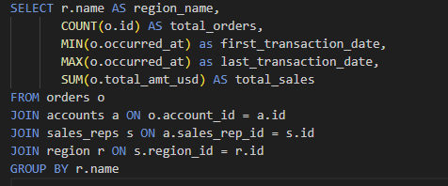

Regional Insights
Northeast leads with $7.74M sales (2,357 orders) – the top-performing region.
Southeast follows closely with $6.45M sales (2,024 orders), showing strong demand.
West contributes $5.92M from 1,634 orders, maintaining steady performance.
Midwest lags at $3.01M sales (897 orders), presenting a major growth opportunity.

Slide 4
MoM Growth (MoM)
The Month-over-Month (MoM) growth shows a mix of strong spikes and less dips across the observed period. There are multiple months with substantial positive growth, notably around October 2014, April 2015, and July 2016, where growth exceeded 40–60%. However, there are also periods of sharp declines, with the most notable drop occurring in January 2017, which after a deepdive I noticed it was because that month only recorded sales for one month. Overall, the pattern suggests cyclical demand, with periods of strong recovery following declines.

Slide 5
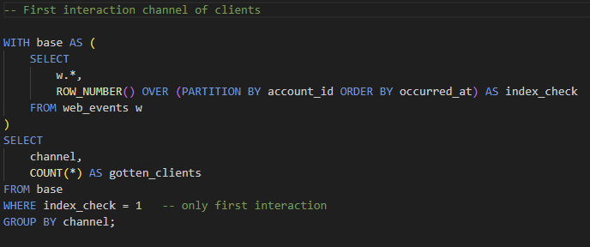
First Interaction Channel
Analysis of first interaction channels shows that Direct traffic accounts for the majority of first-time customer interactions, with 193 clients discovering Parch & Posey this way. Organic search and Facebook follow next with 42 and 41 clients respectively, highlighting the importance of search visibility and social media.
Paid channels like Adwords (31 clients) and Banner ads (23 clients) contribute moderately, while Twitter brings in the fewest (21 clients). This suggests a strong reliance on direct engagement and discoverability rather than paid acquisition.

Slide 6
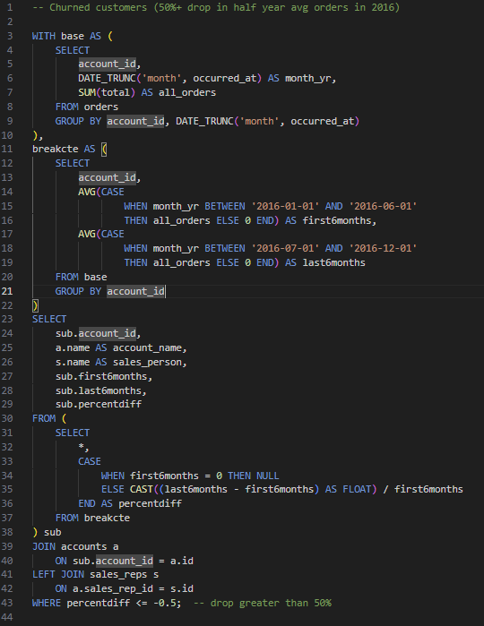
Churned Accounts (50% drop in half year average orders 2016)
Our churn analysis reveals a significant loss of business from several key accounts between H1 and H2 2016.
Major Clients with 100% Drop
PepsiCo: Monthly orders fell from 1,168 → 0 (100% drop)
Apple: Monthly orders fell from 299 → 0 (100% drop)
VF: Monthly orders fell from 1,412 → 0 (100% drop)
WellCare Health Plans: Monthly orders fell from 1,492 → 0 (100% drop)
General Electric, DuPont, Delta Air Lines, Travelers Cos. all dropped to 0 orders
High-Value Accounts with Severe Declines (70–90%+)
Community Health Systems: -82% drop (1,269 → 225)
Whole Foods Market: -84% drop (665 → 109)
Core-Mark Holding: -88% drop (700 → 86)
Time Warner: -77% drop (770 → 177)
Disney: -75% drop (425 → 107)
Overall Impact
Over 20 key accounts show >50% decline
Combined lost volume from PepsiCo, Apple, VF, and WellCare alone exceeds 4,300 monthly orders

Slide 7
General Recommendations
Re-engage High-Value Lost Accounts: Prioritize win-back campaigns for key clients like PepsiCo, Apple, VF, WellCare, and Becton Dickinson who dropped to zero spend. These accounts represent significant revenue opportunities.
Salesperson Performance Reviews: Conduct one-on-one reviews with sales reps owning multiple accounts with sharp declines (e.g., Eugena Esser, Michel Averette, Saran Ram). Assess root causes - churn drivers, lost contacts, or competitive pressure.
Client Health Monitoring: Implement early-warning dashboards (churn risk scores, spend trend alerts) to flag clients whose spend drops >30% month-over-month, so the team can act before full churn.
Channel Mix Optimization: With 193 clients coming through direct but smaller numbers from ads/social, review paid media performance to ensure marketing spend aligns with highest-value acquisition sources.
Product/Service Feedback Loop: Engage churned or low-spend accounts with short surveys or account manager outreach to identify common pain points, feeding insights back to product and support teams.
Executive Focus on Top 20 Accounts: Create a quarterly business review (QBR) process for the top accounts to maintain relationships, showcase ROI, and ensure consistent engagement from leadership.

Slide 8

Parch & Posey
Thank You

